Slide 1
Ants
Alexis, Grace, Candice

Slide 2
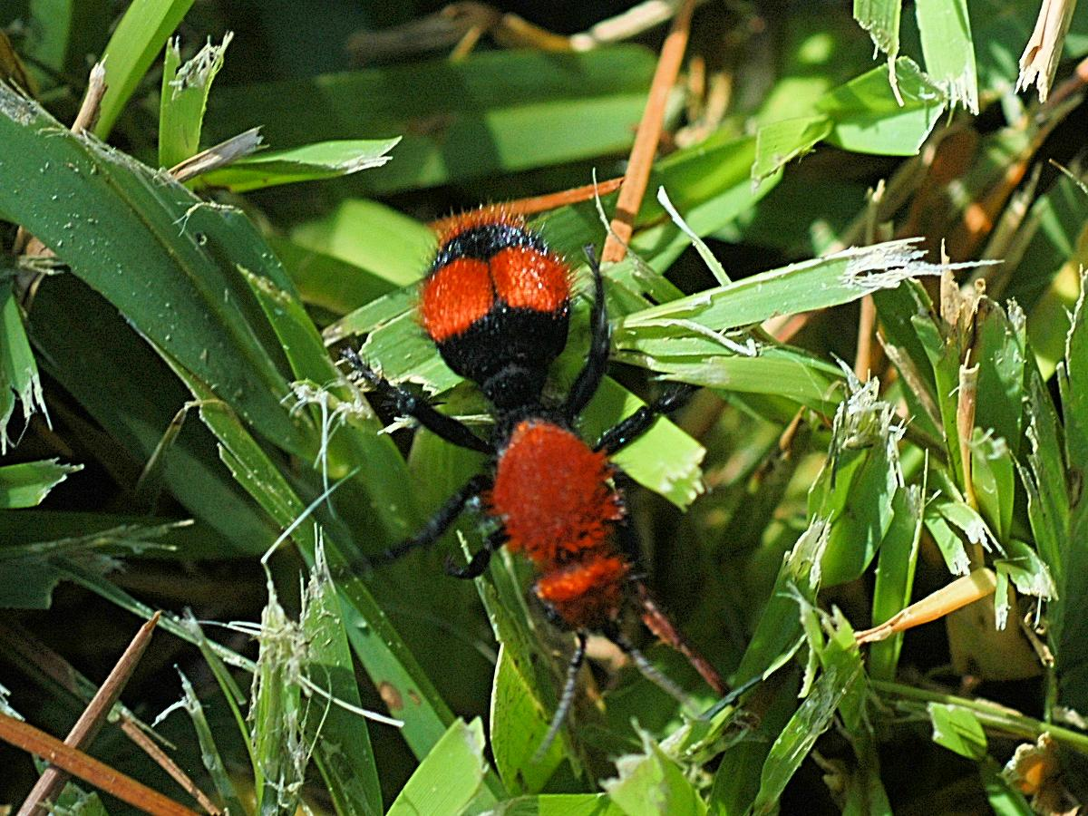
Ants crawling in grass

Slide 3
Ants are….
Ants are one of nearly a million kinds of species of insects.
Ants live together in a colony.
The queen ant lays eggs.
More than 2,500 species of ants live throughout the world.
An ant begins life as a tiny egg laid by the queen.

Slide 4
Ants can…
Ants can not see very well.
The queen ant can live for ten or fifteen years.
The male ants live for only a few months.
Ants live and work together and help each other.
The ants use their antennae to tell them where they are going.
When it is cold ants sleep in their nest.

Slide 5
Ants have….
Ants are insects. All ants have 6 legs and 3 main body parts which are the head, thorax and abdomen.

Slide 6
Ants need….
Ants need cool water.
Ants need food to live.
Ants need space.
Ants need air.

Slide 7
Food
Ants like to drink honey dew. Ants eat fruit and seeds. They even like cookie crumbs.

Slide 8
Habitat:
Ants make their nest underground and in old logs.
Ants like to live in places where it is safe and warm.

Slide 9
Life Cycle:
An ant begins life as a tiny egg laid by the queen.
The egg hatches into a worm like larva. Next, the ant turns into the pupa stage. It looks like a cocoon. Lastly, the adult ant hatches.

Slide 10
Fun Facts!
There are over 20,000 different species of ants .
Ants can be black, brown,red,green,yellow or purple.
Ants have antennae, claws, and wings.

Slide 11
Sources
Ants by Karen Hartley and Chris Macro.
I wonder what it is like to be a ant by Erin m. Hovanec
Ants by James P. Rowan

