Slide 1
Bees
Kyla Peltier, Lucas Mattscheck, Riley Mullen

Slide 2
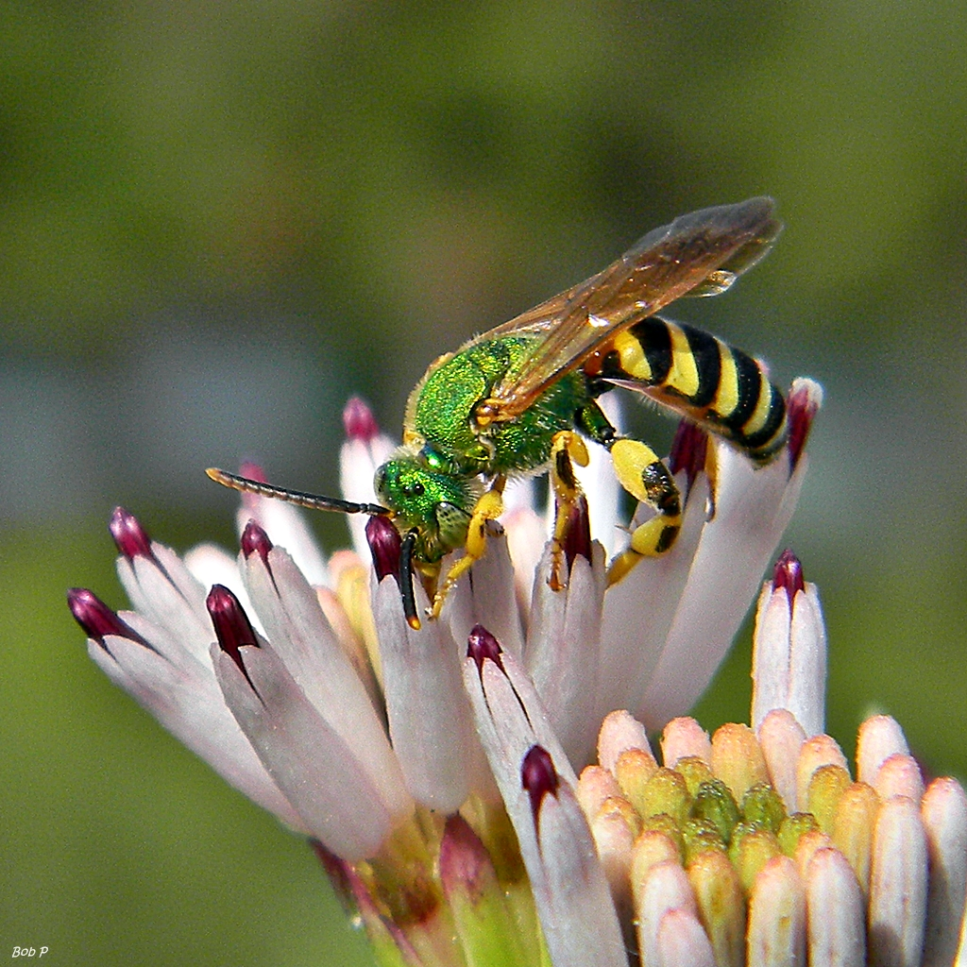
The bee is taking nectar from the flower

Slide 3
Bees are insects.
There are queens, drones, and worker bees.
Bees are pollinators.
Bees are black and yellow.

Slide 4
Bees can fly. They bring nectar from the flowers to the nest to make into honey.
Bees can live together in a nest or a tree.

Slide 5
Bees have:
A head, thorax, and abdomen.
Antennae, wings, and eyes.
Two large eyes that see up, down, forwards, and backwards.

Slide 6
Bees need:
Food, air, water, and space.
Honey bees collect water to drink.
Air to breathe.
Space to live.

Slide 7
Bees eat:
Worker bees collect pollen and nectar every day to feed the hive.

Slide 8
Habitat:
Bees live in a colony.
Bees live in hives that they build in trees, under roofs, in old termite mounds, underground, or in caves.

Slide 9
Bees Life Cycle:
First they are a egg.
Second they are larva.
Third they are pupa.
Fourth they are adults.

Slide 10
Fun Facts:
Bees can sting.
When bees fly their wings go so fast that they make the buzzing sound.

Slide 11
Sources:
Bee - By Karen Hartley
Honey Bees - By Clint Twist
Life of the Honey Bee - By Heiderose

