Slide 1
gRasshoppers
by:Leo Emery, Raegan Kiley, Emma Bishop Pike

Slide 2
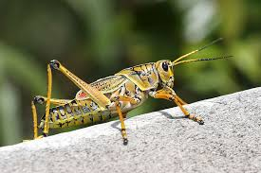
This gRASSHOPPER HAS MANY COLORS

Slide 3
Grasshoppers are:
-Insects
-Some of the best singers in the insect world
-Herbivores. They eat only plants.

Slide 4
Grasshoppers can...
They can glide and jump really far.
Grasshoppers can leap away from their enemies.
They can have cool colors and designs. They can eat.

Slide 5
Grasshoppers Have….
- a head
-thorax
-abdomen
- 6 legs
- eyes
- wings.

Slide 6
GRASSHOPPERS FOOD.
Grasshoppers are herbivores.Grasshoppers eat plants like leaves and grass.

Slide 7
grasshoppers need:
Grasshoppers need water food air and space.

Slide 8
grasshoppers habitat:
Grasshoppers live in environments everywhere in the world.

Slide 9
Life cycle
Grasshoppers start as an egg. When the egg hatches they are small nymphs. Then they keep on growing until they are big adults.

Slide 10
fun facts:
There are over 600 species of grasshoppers.
A baby grasshoppers does not have wings.
Grasshoppers use their back wings to fly.

Slide 11
sources:
Grasshoppers by Emily K. Green
Grasshoppers by Mary Ann McDonald
Grasshoppers by James P.Rowan

