Slide 1
Ladybugs
by:Zane Smith, Kaitlyn Freel, Lucas Sasseville

Slide 2
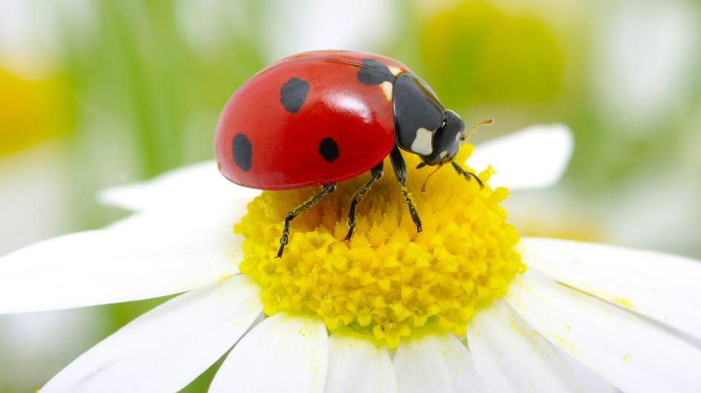
Notes:
This Ladybug is red with several spots.

Slide 3
Ladybugs are insects.
Ladybugs are small beetles.
Most are red or yellow with black spots.

Slide 4
ladybugs can...
Keep predators away with their bright colors.
Ladybug larva can feed on aphids that eat farmers crops.
Ladybugs can fly.

Slide 5
Ladybug have….
LAdYbuGS hAVe a
head, thorax and abdomen!
They also have 6 legs

Slide 6
lADYBUGS NEED...
LADYBUGS NEED WATER, FOOD, AIR
AND SPACE to survive.
LADYBUGS NEED TO LIVE IN A PLACE
WHERE THEY CAN FIND FOOD.

Slide 7
FOOD…..
MOST LADYBUGS EAT APHIDS But some eat plants!
This is helpful to farmers because aphids eat their plants!

Slide 8
Ladybugs live in a garden,
where there are flowers. They live where they can lay eggs.
North America, Asia, Europe, and
Africa!

Slide 9
life Cycle……
The first stage of the ladybug is the egg.
and then it hatches into a grub/larva.
The larva eats and eats until it has turned into a pupa. After a week, the pupa splits open and out crawls an adult ladybug.

Slide 10
Fun Facts
A ladybug larva is called grubs. They are a beetle!
Ladybugs have spots. The ladybugs colors make animals think they are poisonous.
Ladybugs do not bite.

Slide 11
Sources
Life of a Ladybug: by Heidi Rose
The Ladybug: by Sabrina Crewe
Ladybug:Karen Hartley

